Slide 1
Reusable Automation Framework
- Azar

Slide 2
KEYPOINTS of Reusable Automation Framework
Automation Framework is a Reusable Script less Framework.
It includes a single Driver script, associated with multiple Function Libraries.
Using this Framework, creating an Automation scripts and Maintenance would be Easy.
This Hybrid framework is combination of Keyword with the Data driven approach.
Framework can handle both Descriptive Programming and Object Repository objects.
Parametrization - Framework can handle Multiple Iterations for each test case and also it uses different data for each iteration.
Easy to categorize the Executable/ Non Executable Test cases.
After every Execution, the Script can generate the Consolidated & Individual HTML report.
Individual HTML report will be interlinked with the screen shot for each step.
Exception and Error handling is performed for each step.
Capable of handling Independent Custom Function.

Slide 3

Framework Architecture
Driver Script
Script is associated with
Function Library
Test Data
Test Script
Consist of List of
Test Case with Description in Excel
AUT
Application Under Test
Report
HTML & QTP Reports generation
Notification
Email Notification

Slide 4
Framework Flow Chart
Start
Driver Script
Execution Flag
Test Script
Execution Flag
No
Yes
Test Data
Load
Obj. Desc & Keywords
AUT
Report Generation
Execution Stops

Slide 5
Test Script & Test Data
Test Script:
Driver Excel contains the number of Test Cases which are automated for AUT application.
The automation test cases are Executed based on the setup Flag Execute Yes/ No
The test cases will be executed based on the keyword in the driver excel under EVENT column.
Test Data:
Test Excel sheet contains the data related to all the automated Test Cases.
Scripts required the dynamic test data will be fetched from Test Data sheet.
These dynamic data are fed under VALUE column of the Driver excel sheet from Test

Slide 6
REPORTS
There are 3 kinds of reporting structure is maintained as part of the Reusable TCS Automation Framework
1. Individual HTML Report
2. QTP Report
3. Consolidated HTML Report
HTML reports will be generated at the end of each Test Case Execution.
The report contains the Description, Actual and Expected result of each step with Passed/Failed status.
Screen shots are embedded with each step of HTML Report for the manual reference.
Consolidated Report gives the status of overall automation execution.
Advantages:
This HTML reports consume minimum storage space hence, we can store it & use it for the future reference.
QTP report is helpful during the automation development
Consolidated report is highly useful when we are running series of test cases in a batch run/Scheduling.

Slide 7
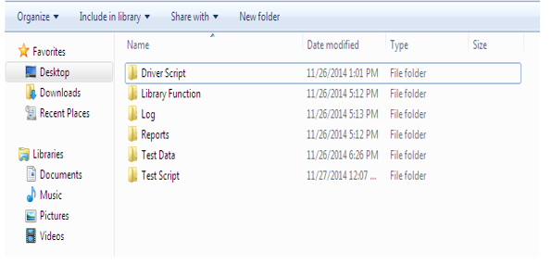
Framework Folder Structure

Slide 8
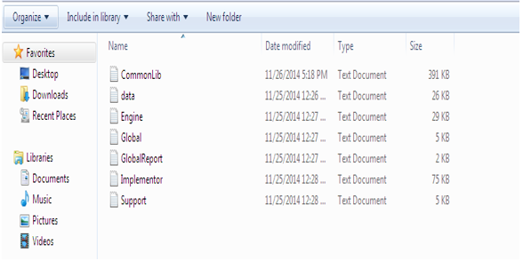
Folder Structure - Function Library

Slide 9
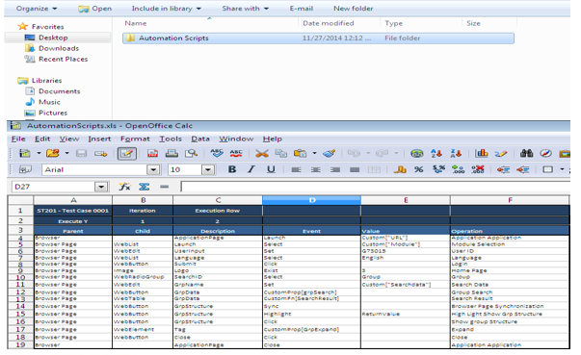
Folder Structure - Automation Scripts Excel

Slide 10
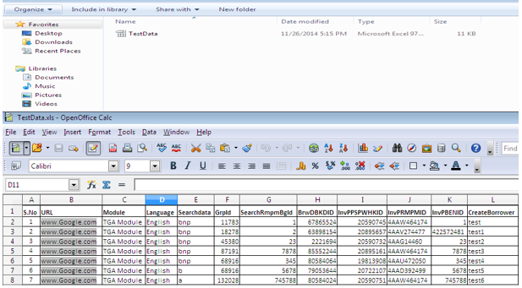
Folder Structure – Test Data Excel

Slide 11
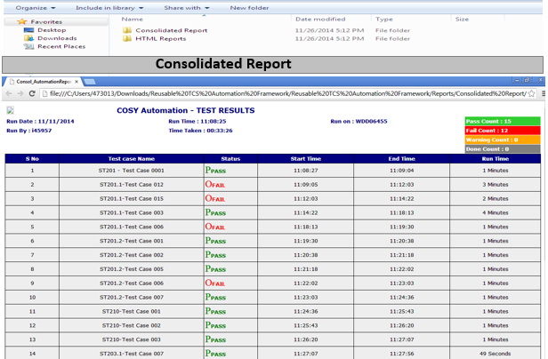
Folder Structure - Automation Reports

Slide 12
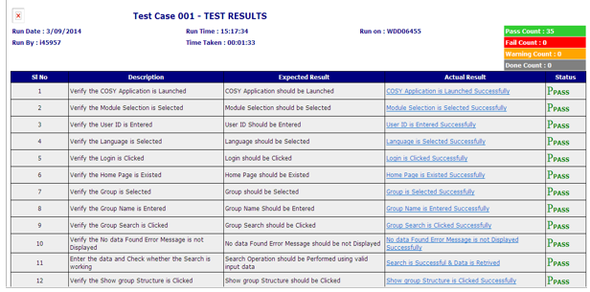
Individual HTML Report

Slide 13
THANK YOU

